Slide 1
Introduction To Wireless Communications and Networks
Dr.Mohammed Abdalla Youssif
IT Department
1

Slide 2
OUTLINE
2
BACKGROUND
Location based services : aim
Predictive Spatial Queries: Definition
Predictive Spatial Queries: Common types
Predictive Queries: Applications
Predictive Spatio-Temporal Query
Spatio-temporal Data Management : Open Research Areas
Challenges
Conclusions
Notes:
2

Slide 3
BACKGROUND
3
Wireless Communications
Responsibility: Communication engineers
Physical layer
Data link layer
Networks
Responsibility: Software Engineers
Application layer
Network Layer
Transport Layer
Notes:
Wireless Communications and networks – William Stallings
3

Slide 4
BACKGROUND
4
What is the role of each layer:
Application layer
Network Layer
Transport Layer
Data link layer
Physical layer
Notes:
Wireless Communications and networks – William Stallings
4

Slide 5
Wireless Comes of Age
Guglielmo Marconi invented the wireless telegraph in 1896
Communications by encoding alphanumeric characters in analog signals
Sent telegraphic signals across Atlantic ocean
Communications satellites launched in 1960s
Advances in wireless technology
Radio,television,mobiletelephone,communication satellites
More Recently
Satellite communications, wireless networking, cellular technology
5
Notes:
5

Slide 6
Broadband Wireless Technology
Higher data rates obtainable with broadband wireless technology
Graphics, video, audio
Share same advantages of all wireless services: convenience and reduced cost
Service can be deployed faster
No cost of cable
Service is mobile, deployed almost anywhere.
6
Notes:
Boradband هو البث على نطاق واسع وعدة نطاقات وليس نطاق واحد
وبث مجموعة من الاشارات فى نفس الوقت
6

Slide 7
Three Faces of Networking
Fundamental concepts of networking
How data moves from one computer to another over a network
Theories of how network operate
Technologies in use today
How theories are implemented, specific products
How do they work, their use, applications
Management of networking technologies
Security
Network Design
Managing the network

Slide 8
Topics Coverage
Data Communications
TCP/IP
8
Notes:
Boradband هو البث على نطاق واسع وعدة نطاقات وليس نطاق واحد
وبث مجموعة من الاشارات فى نفس الوقت
8

Slide 9
DEFNTION
9
Data communications (DC) is the process of using communication technologies to transfer data from one place to another, and vice versa.
It enables the movement of electronic or digital data between two or more nodes, regardless of geographical location, technological medium or data contents.
Common example of data communications is a computer connected to the Internet via a Wi-Fi connection, which uses a wireless medium to send and receive data from one or more remote servers.
Notes:
9

Slide 10

DEFNTION
10
Notes:
10

Slide 11
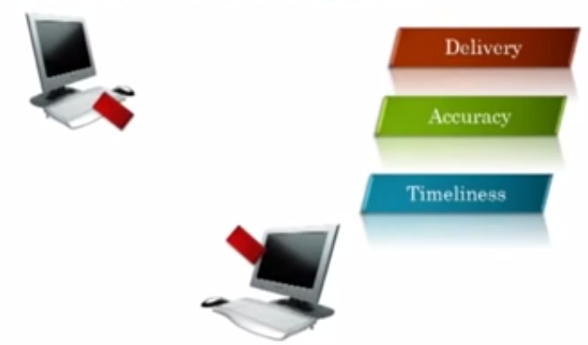
Effectiveness of data Communication
11
The Effectiveness of data communication depends on three fundamental characteristics
Notes:
Delivery : system must deliver data to correct destination
Accuracy :system must deliver correct data.
Timeliness : system must deliver data in reasonable time
11

Slide 12
Communications Tasks
Transmission system utilization | Addressing
Interfacing | Routing
Signal generation | Recovery
Synchronization | Message formatting
Exchange management | Security
Error detection and correction | Network management
Flow control

Slide 13
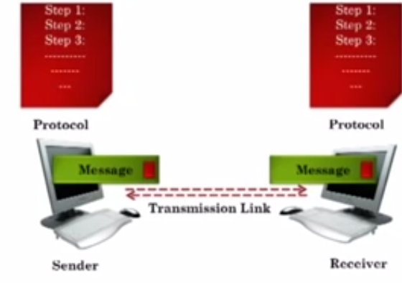
Components of Data Communication
13
Notes:
Message
Sender
Receiver
Protocols: set of rules for data communication
Transmission link : physical link between sender and receiver.
13

Slide 14
Topology
14
How To connect 2 or More devices ? Topology
Two or more devices connect to a link and two or more links form topology.
Notes:
14

Slide 15
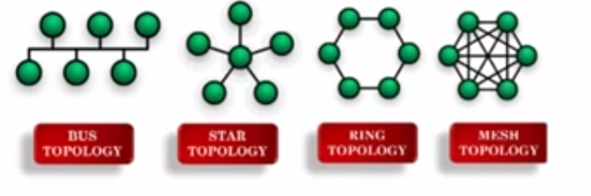
Types of Topology
15
Bus Topology
Star Topology
Ring Topology
Mesh Topology
Notes:
15

Slide 16
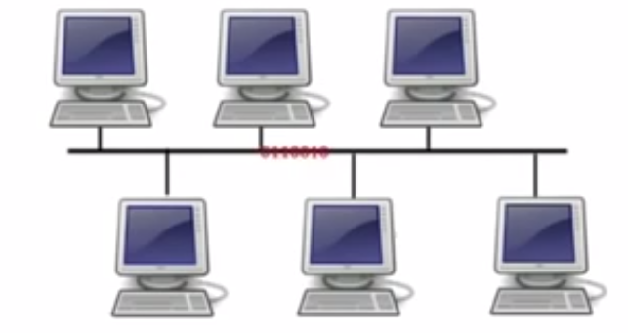
Bus Topology
Bus topology is a specific kind of network topology in which all of the various devices in the network are connected to a single cable or line.
16
Notes:
16

Slide 17
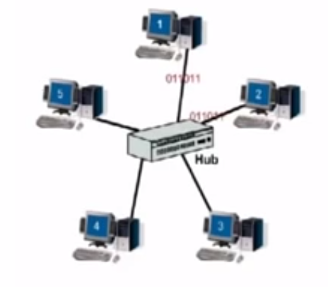
Star Topology
Set or more devices connected to central Hub
The major disadvantage is if the central hub fail all devices will be disconnected.
17
Notes:
17

Slide 18
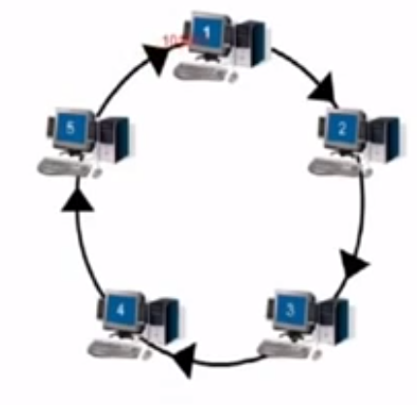
Ring Topology
computer network configuration which each device connect to each other forming circle.
Each packet is go to around until it reaches final destination.
18
Notes:
18

Slide 19
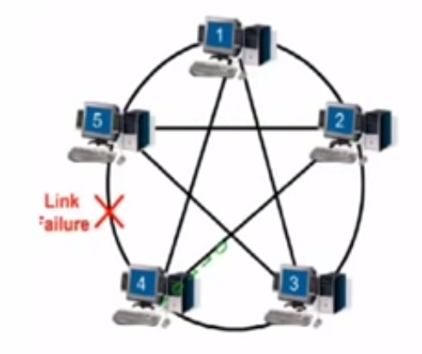
Mesh Topology
Each computer and network device is interconnected with one another, allowing for most transmissions to be distributed, even if one of the connections go down.
19
Notes:
19

Slide 20
A Communications Model
Source
generates data to be transmitted
Transmitter
Converts data into transmittable signals
Transmission System
Carries data
Receiver
Converts received signal into data
Destination
Takes incoming data

Slide 21
Communications Tasks
Transmission system utilization | Addressing
Interfacing | Routing
Signal generation | Recovery
Synchronization | Message formatting
Exchange management | Security
Error detection and correction | Network management
Flow control

Slide 22
Layered Tasks
We use the concept of layers in our daily life. As an example, let us consider two friends who communicate through postal mail. The process of sending a letter to a friend would be complex if there were no services available from the post office.

Slide 23
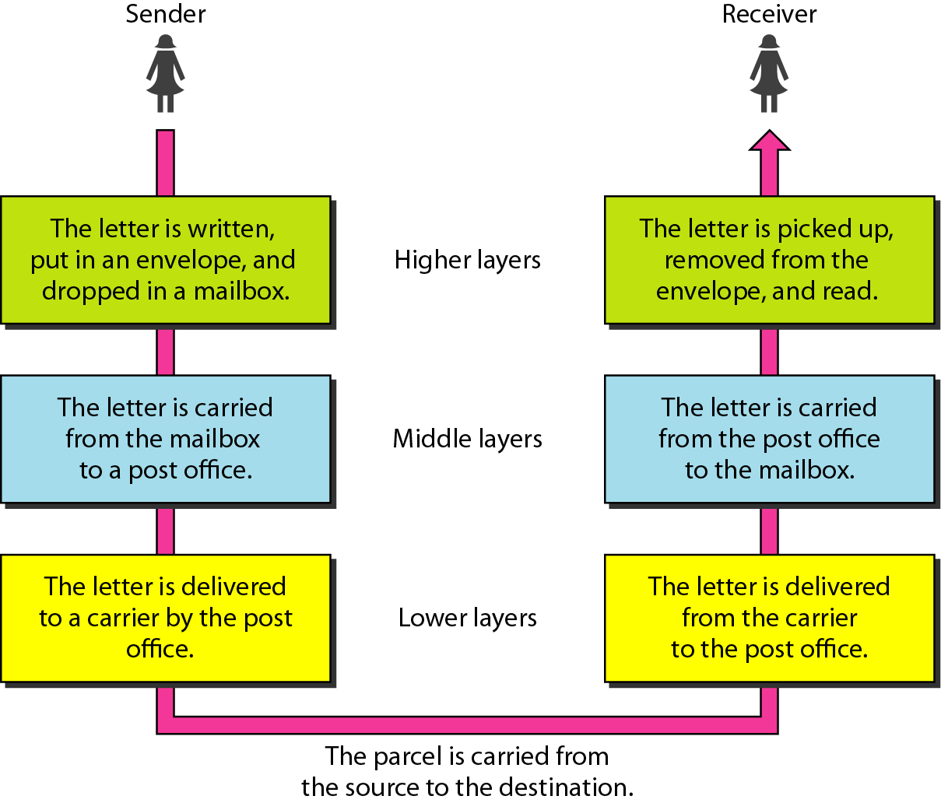
Figure Tasks involved in sending a letter

Slide 24
The OSI Model
Established in 1947, the International Standards Organization (ISO) is a multinational body dedicated to worldwide agreement on international standards. An ISO standard that covers all aspects of network communications is the Open Systems Interconnection (OSI) model. It was first introduced in the late 1970s.

Slide 25
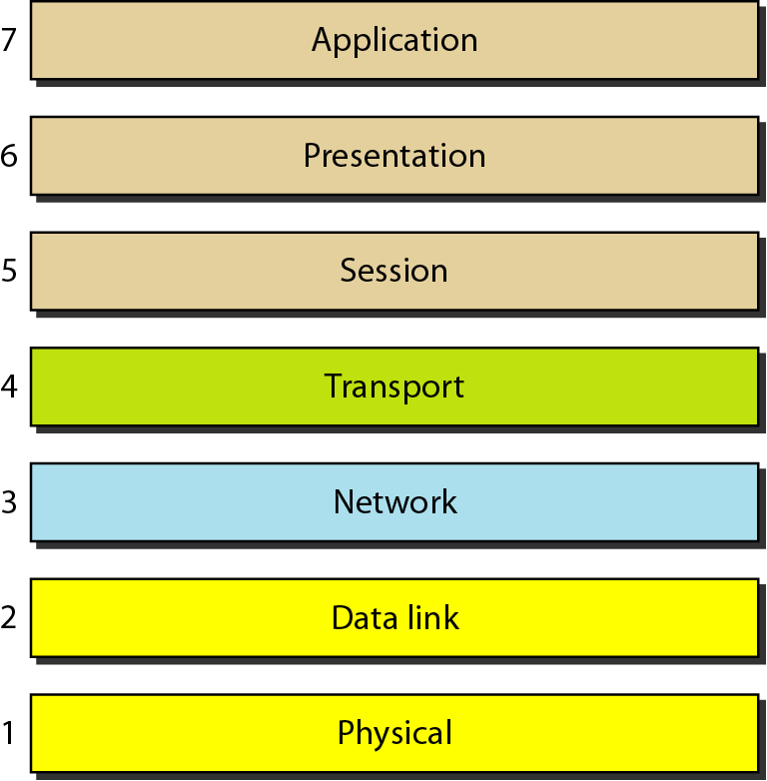
Figure Seven layers of the OSI model

Slide 26
2-3 LAYERS IN THE OSI MODEL
In this section we briefly describe the functions of each layer in the OSI model.
Topics discussed :
Physical Layer Data Link Layer
Network Layer
Transport Layer
Session Layer
Presentation Layer
Application Layer

Slide 27
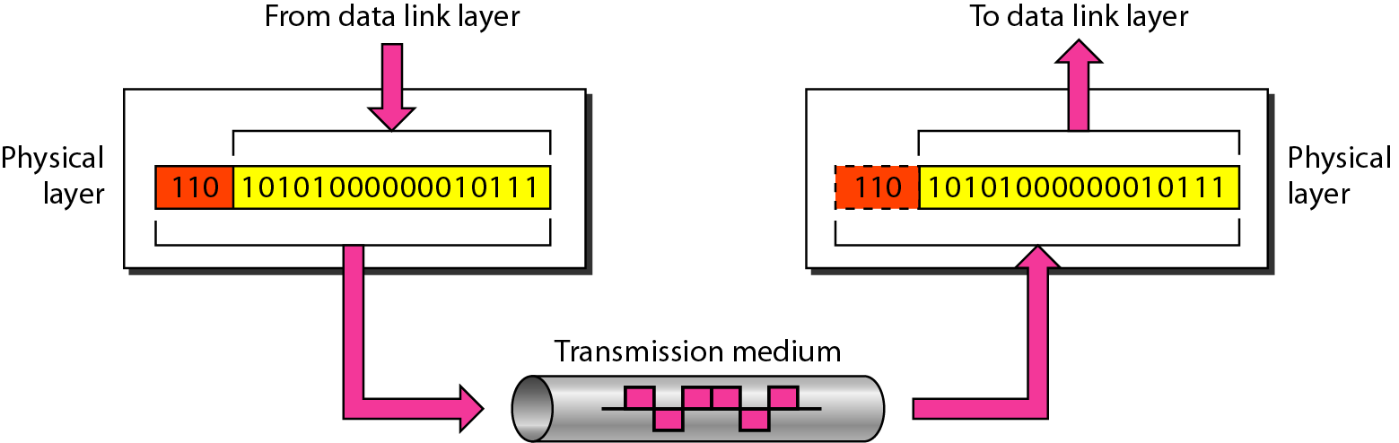
Figure 2.5 Physical layer

Slide 28

Note
The physical layer is responsible for movements of
individual bits from one hop (node) to the next.

Slide 29
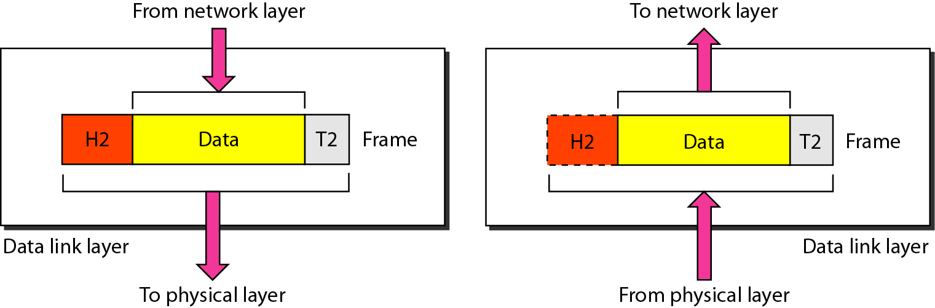
Figure Data link layer

Slide 30
Note
The data link layer is responsible for moving frames from one hop (node) to the next.

Slide 31
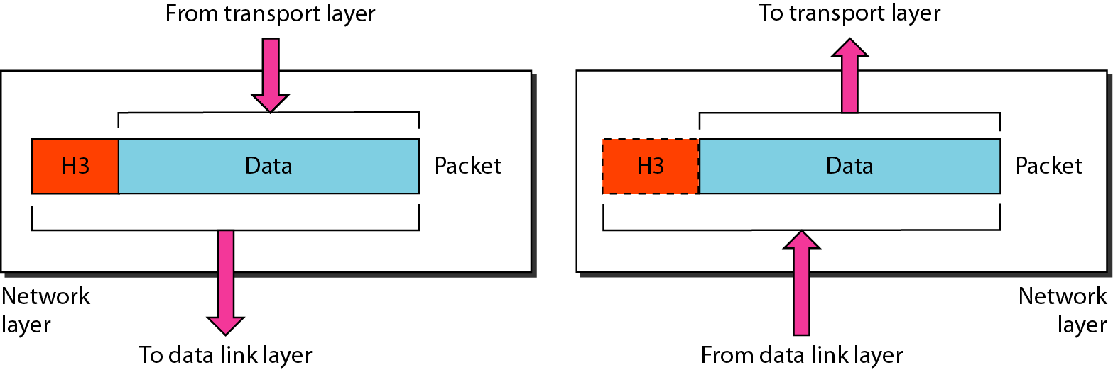
Figure 2.8 Network layer

Slide 32
Note
The network layer is responsible for the delivery of individual packets from
the source host to the destination host.

Slide 33
Note
The transport layer is responsible for the delivery of a message from one process to another.

Slide 34
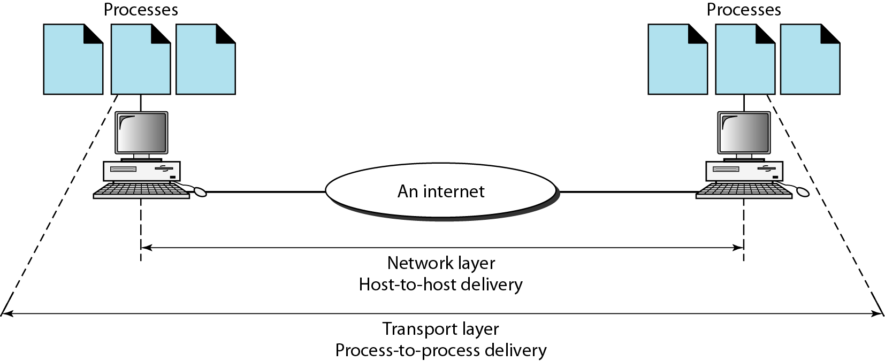
Figure 2.11 Reliable process-to-process delivery of a message

Slide 35
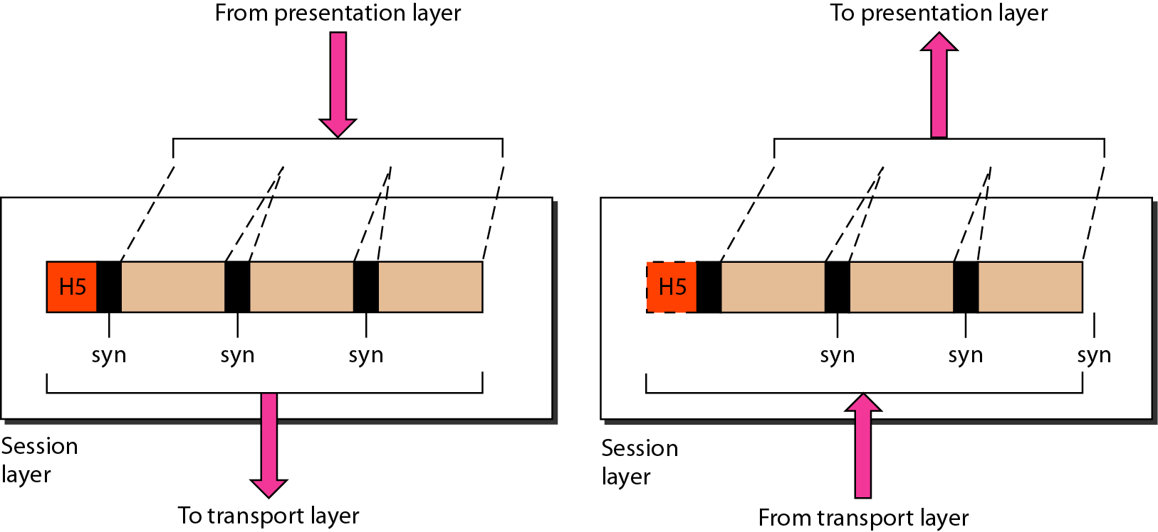
Figure 2.12 Session layer

Slide 36
Note
The session layer is responsible for dialog control and synchronization.

Slide 37
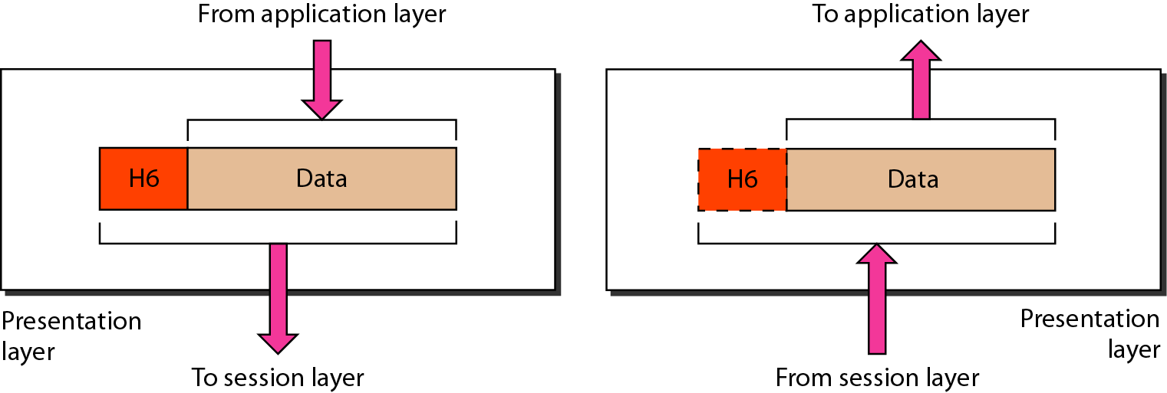
Figure 2.13 Presentation layer

Slide 38
Note
The presentation layer is responsible for translation, compression, and encryption.

Slide 39
Note
The application layer is responsible for providing services to the user.

Slide 40
Layer 1: Physical Layer
Responsible of:
Transmitting individual bits from one to the next.
Physical characteristics of interface and media.
Representation of bits: a stream of bit(0s,1s),
Data rate.
Synchronize of bits
Line configuration
Physical topology
Transmission mode

Slide 41
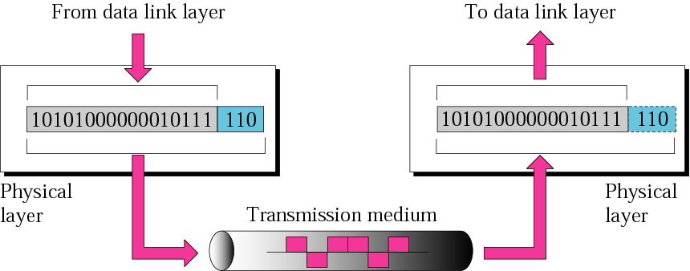
Physical Layer cont.

Slide 42
Layer 2: Data Link layer
Responsible of:
Moving frames from one hop (node) to the next.
Framing: divided the stream of bits received from the network layer manageable data units called frames.
Physical address (MAC address).
Flow control.
Error control: added trailer to the end of frame.
Access control.
Hop to hop delivery

Slide 43
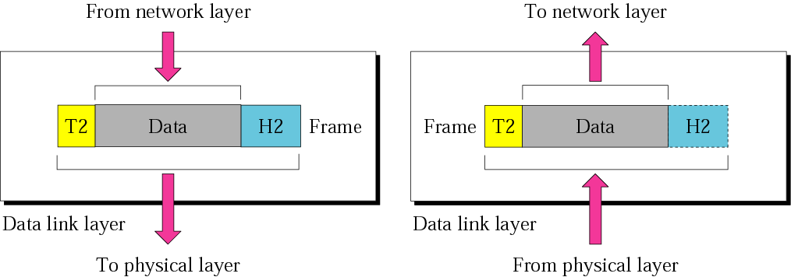
Data Link layer cont.
10110110101
01100010011
10110000001

Slide 44
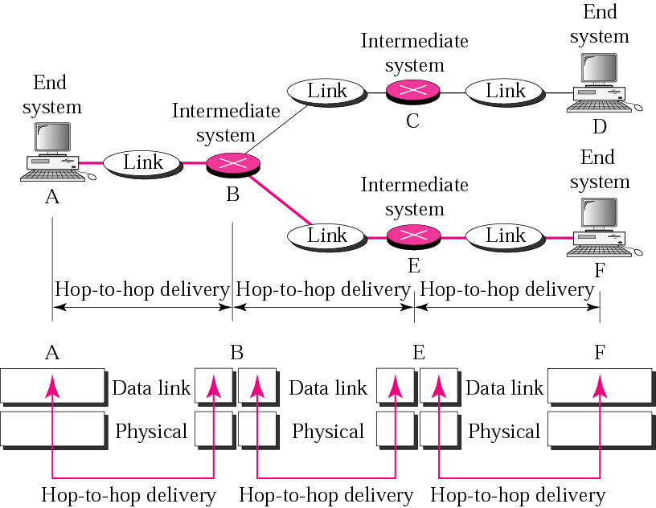
Hop-to-Hop delivery

Slide 45
Layer 3: Network Layer
The network layer is responsible:
The delivery of individual packets from the original source to the final destination .
Logical addressing: if the packet passes the network boundary we need another addressing system to help (source to destination) connection.
Routing : route or switch the packet to final destination.
Source-to-destination delivery (End-to-End).

Slide 46
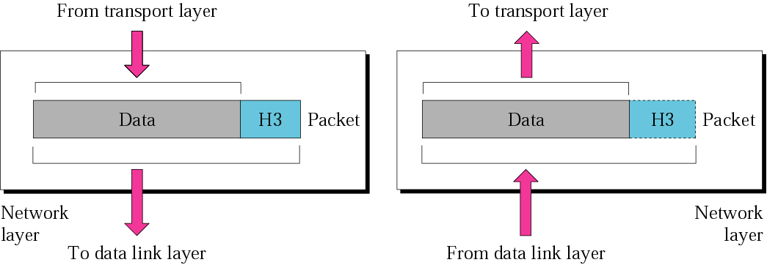
Network Layer cont.

Slide 47
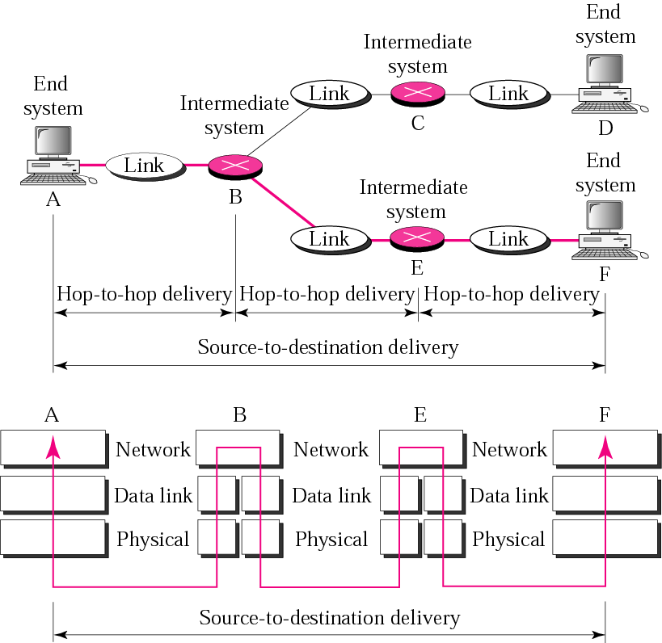
Source-to-Destination delivery

Slide 48
Layer 4: Transport Layer
The transport layer is responsible for:
Service point or Port addressing
Segmentation and reassembly : a message is divided into transmittable segments each segment containing a sequence no.
Connection Control: connection oriented or connectionless.
Flow control
Error control

Slide 49
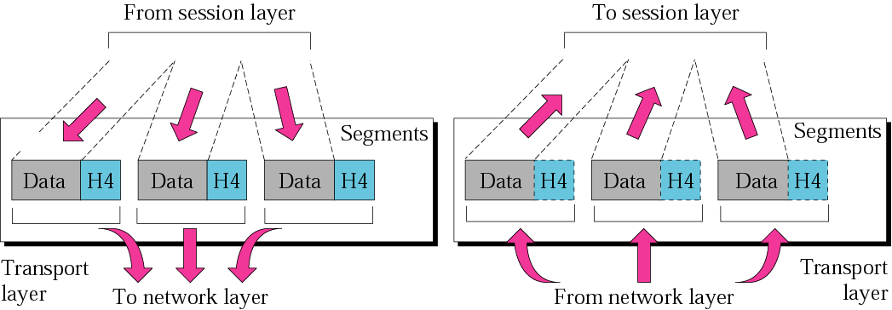
Transport Layer cont.

Slide 50
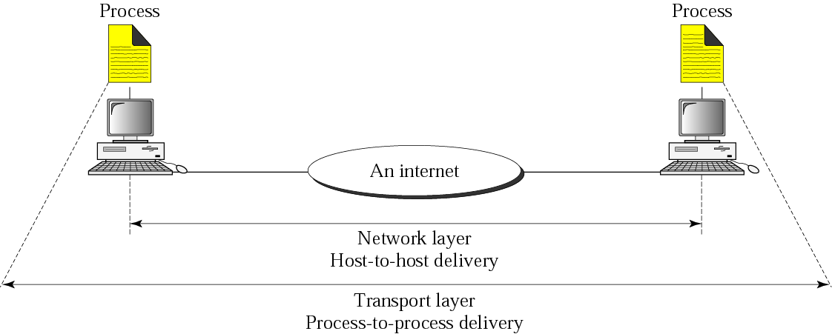
Reliable process-to-process delivery of a message

Slide 51
Layer 5: Session Layer
Dialog control: design to establish, maintain, and synchronize the interaction between communicating systems.
Synchronization: it allows a process to add checkpoints or synchronization points to a data stream.

Slide 52
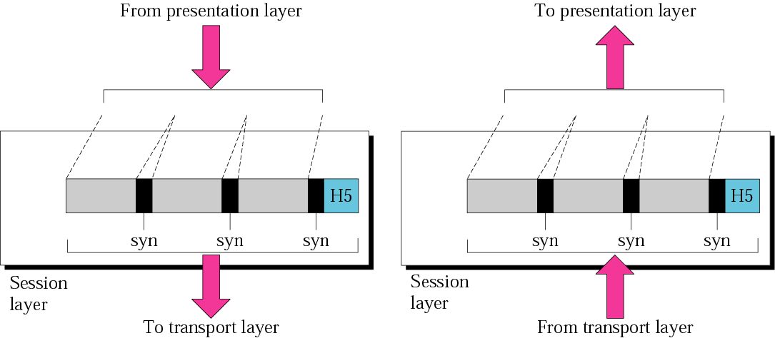
Session Layer cont.

Slide 53
Layer 6 :Presentation Layer
Design to the handle the syntax and semantic of the information exchanged between 2 systems.
And design for data translation, encryption, decryption, and compression.

Slide 54
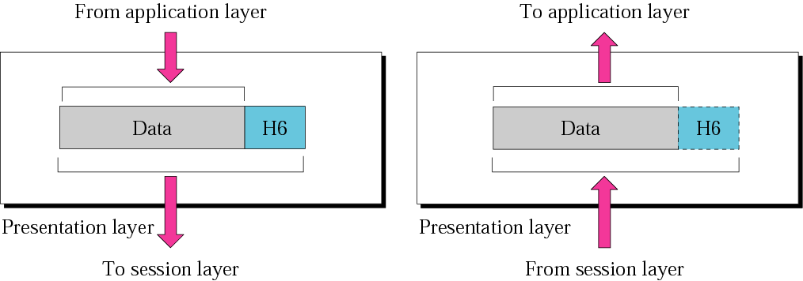
Presentation Layer cont.

Slide 55
Layer 7: Application Layer
The application layer is responsible for providing services to the user.
Mail services
File transfer, access and management
Remote log-in or network virtual terminal
Accessing the World Wide Web
Directory service

Slide 56
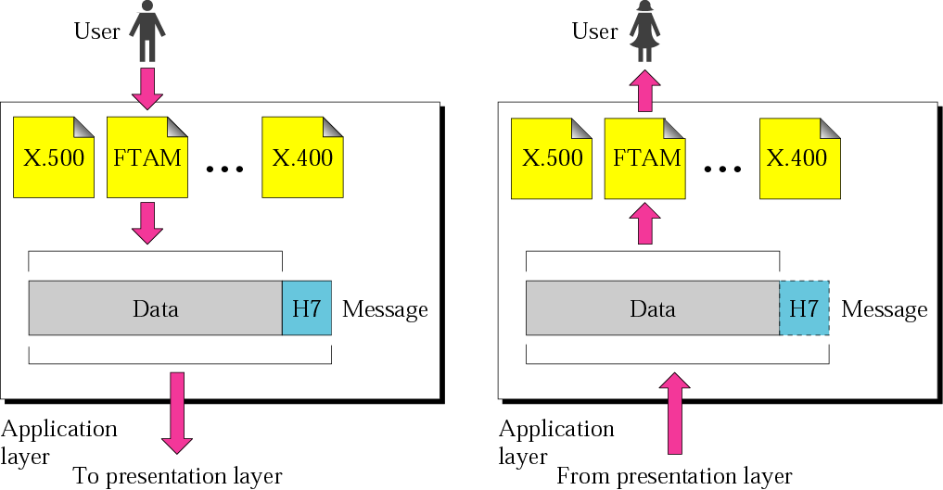
Application Layer cont.
SMTP
Telnet
HTTP
SMTP
Telnet
HTTP

Slide 57
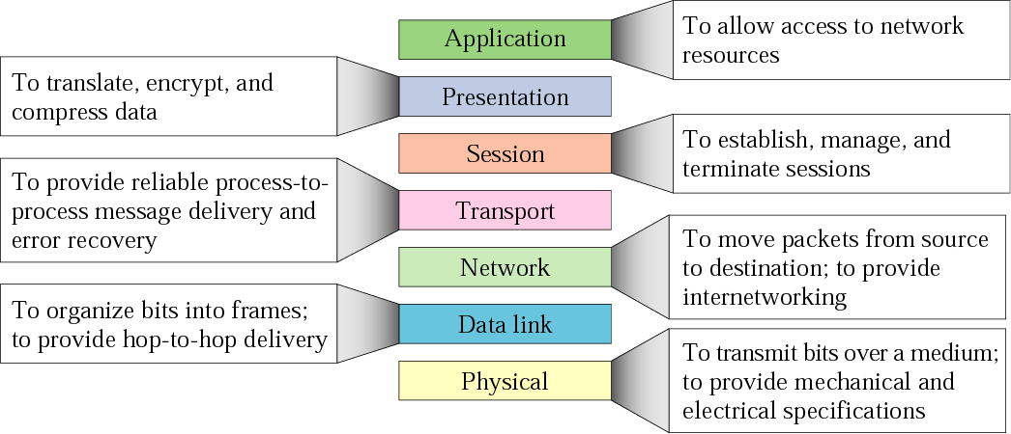
Summary

Slide 58
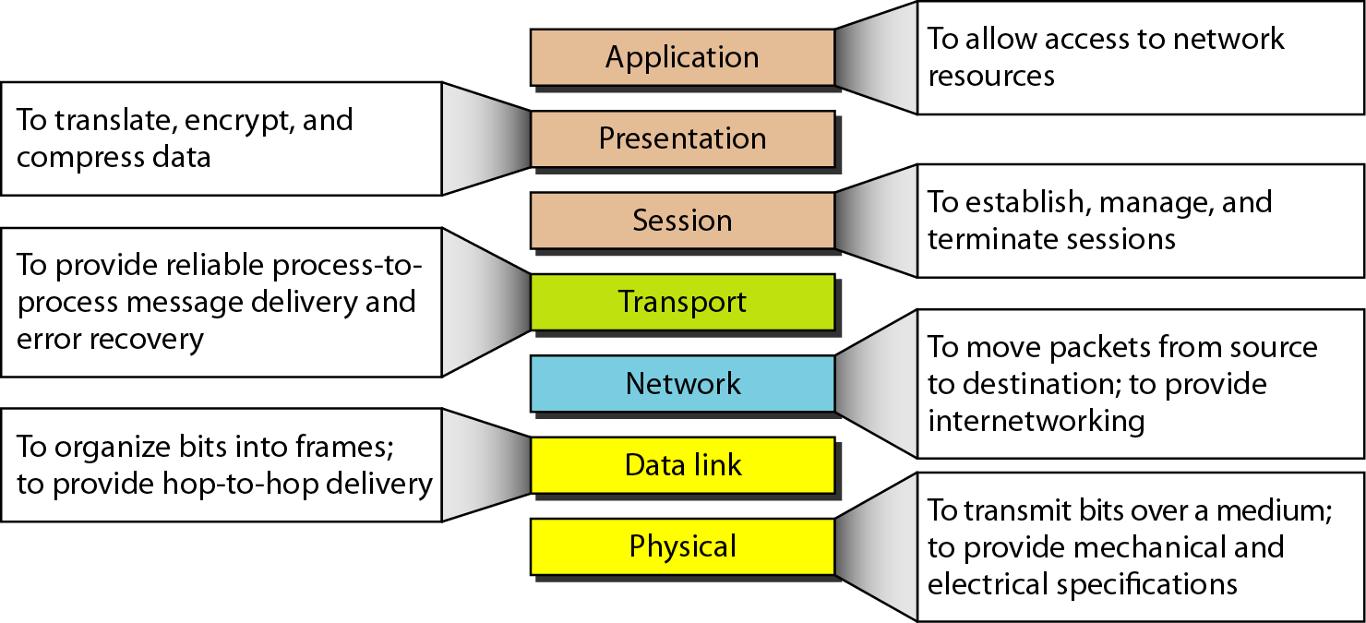
Figure 2.15 Summary of layers

Slide 59
2-5 ADDRESSING
Four levels of addresses are used in an internet employing the TCP/IP protocols: physical, logical, port, and specific.
Topics discussed in this section:
Physical Addresses Logical Addresses Port Addresses Specific Addresses

Slide 60
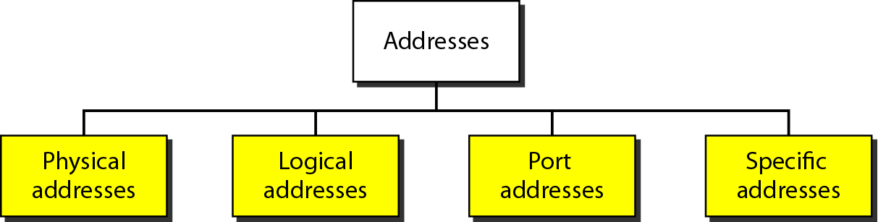
Figure 2.17 Addresses in TCP/IP

Slide 61
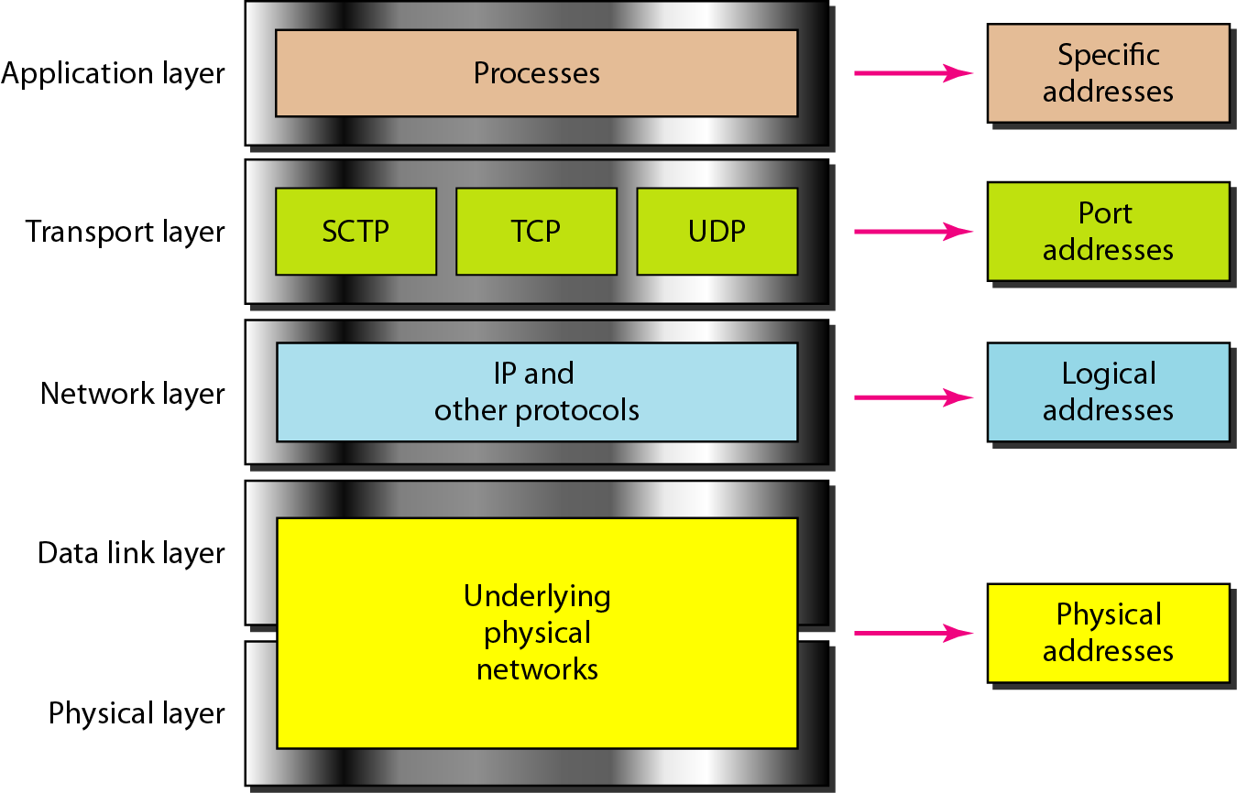
Figure 2.18 Relationship of layers and addresses in TCP/IP

Slide 62
DEVICES :
Hub, a distributor that has a lot of ports which connected to computers.
Switches, like a hub but it transmit packets to it destination
Bridge, it is used to connect two similar LANs.
Routers, choose the best path to transmit the packet.
Gateway, it is use to connect two deferent LANs and connect different application protocols.
Repeaters, repeats signals that travels via long distance

Slide 63
Network devices With Layer
Layers | Network Devices
Application Layer | Application gateway
Transport Layer | Transport gateway
Network Layer | Router and gateway
Data link layer | Bridge and Switch
Physical Layer | Repeater, Hub and Modem.

Slide 64
Questions ?
64
Notes:
64

